Slide 1
Used Cars Data Analytics
IDS Project Presentation
2019-20
BY:
Sai Pranav. M - 296
Rohan Bennur - 1718
Shashank Bhari - 1601
Mentor:
Prof. Jamuna S Murthy
(Assistant Professor),CSE.

Slide 2
Agenda
To perform few data science operations on the data set of used cars to help in predicting the approximate buying price.

Slide 3
Introduction
This project is about analyzing the “used cars” data set.
The data set contains 6016 rows and 12 columns.
Data set gives Info about 3 categorical types of data and 4 Numerical types of data.
Contains 3% of missing values.
We will make different type of data analytics like Data Cleaning ,
Hypothesis testing, Co-relation , Graph Visualisation.

Slide 4
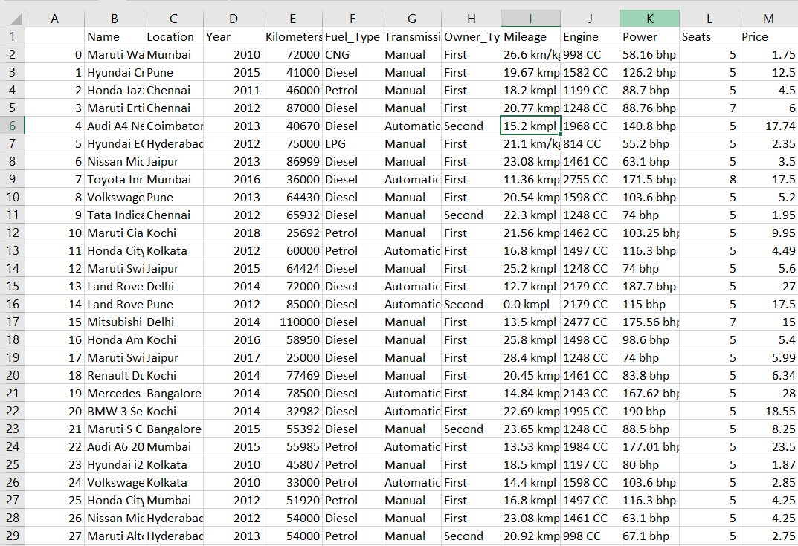
Dataset

Slide 5
Scope and Motivation
This analytics helps buyers to know the minimum requirements for buying a used car.
Sellers also can scale their car price according to the analysis by getting to know what variables to consider before selling an used car.

Slide 6
Tools ,Technology and References
Python libraries like NumPy, pandas, matplotlib are used for this project completion.
Pyplot from matplotlib are used to plot matrix plot and pie charts.
Scipy library also helpful in hypothesis testing to calculate z score and P value.
References:
learnpython.org
kaggle.com
Pandas.pydata.org
Matplotlib.org

Slide 7
Data - Cleaning
There are missing values in column of Engine , Mileage, seats, and Power.
In this data analytics we replaced missing values by mean of the column or the upper row values.
Engine and Seats missing values are replaced by the average values of the respective columns . This is done because taking the median is not a appropriate method because if the sample rows are increased then , there is possibility that median varies more than mean.
Mileage and power values are replaced by the upper row value , this is done because taking mean and median seems not appropriate .

Slide 8
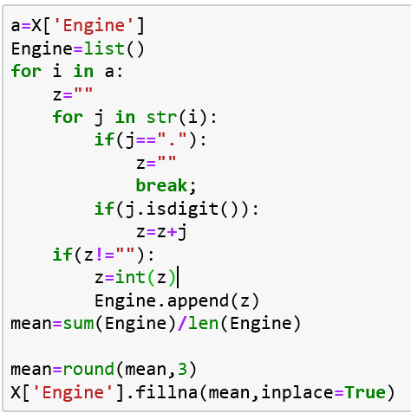

Data-Cleaning

Slide 9
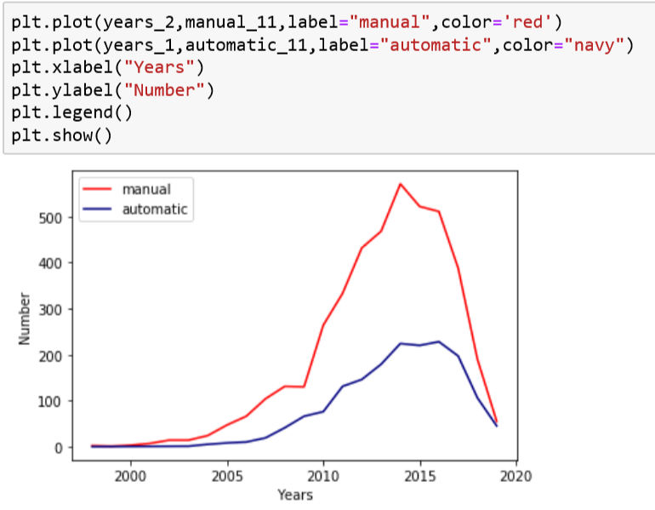
Visualization
This is Graph Visualization of Automatic and Manual transmission type of cars ,over few years.
Insights:
More number of options of manual cars are available.
More number of cars manufactured in 2014-16 are available for the buyers.

Slide 10
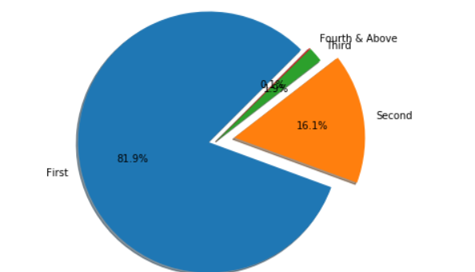
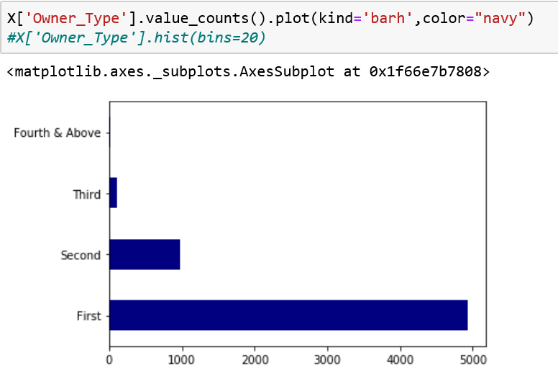
Visualization
This is Graph Visualization using pie chart of car Owner type ,like First / Second Owner.
Insight:
Majority of Owner type is First owner, has about 82% (5000)of the sample data.
But third and fourth constitute only
2% (100) of whole data.

Slide 11
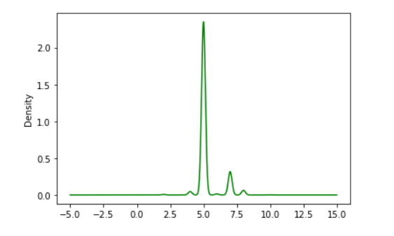
Visualization
Data visualization of number of seats is done by plotting density vs number of seats .
Insights:
Number of cars having 4 to 5 seater is very high , so there are a lot of options for buyers in this segment.

Slide 12
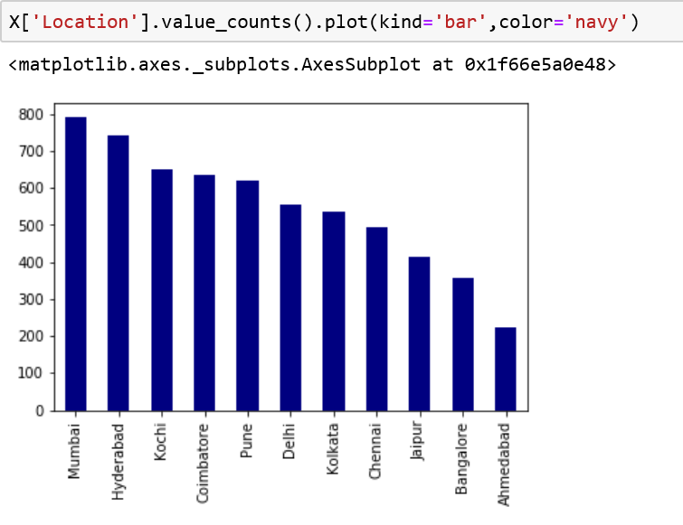
Visualization
This graph tells us about the number of cars in each city from the dataset analysed.
Insights:
Mumbai has more number of owners who are willing to sell their cars. This has a count up to 800
Whereas, Ahmedabad has the least(around 200).

Slide 13
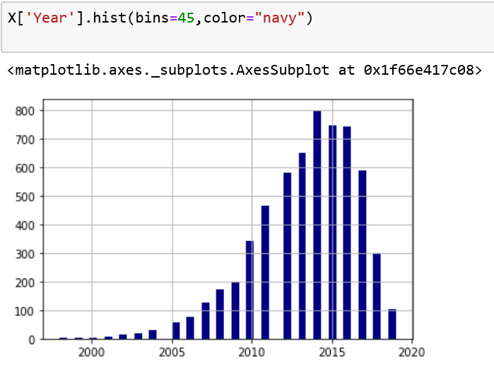
Visualization
This is a graph of frequency versus year.
Insights:
The year of manufacture of most of the cars analyzed is between 2014-16.
So most of the cars are being sold after 5 years of being bought.

Slide 14
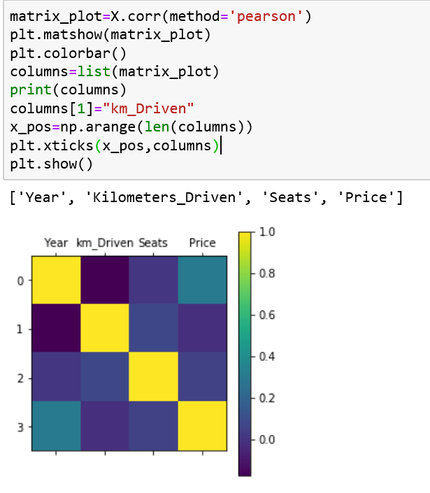
Correlation
The Shown Co-relation graph yellow has the co-relation
co-efficient of 1 and navy blue has co-relation of -1.
0-0.3 is considered weak correlation
Most correlated:
Year and Price has about 0.305 correlation coefficient. Price increases with year . This correlation coefficient is slightly greater than 0.3
Least correlated:
Kilometer Driven and year , these are weakly correlated . Has correlation -0.17

Slide 15
Hypothesis Testing
Can we say that mean number of seats in cars is greater than 5?
H0: Average number of seats in the cars is less than or equal to 5
H1:Average number of seats in cars is greater than 5
H0: μ <=5 H1: μ >5
P value is very low it is 1.4761699880812001e-156 → 0 this value is less than 0.05.
Hence H0 is rejected and the H1 is true.
He we conclude that mean number of seats in cars is greater than 5.

Slide 16
“THANK YOU”

